Slide 1
Project Name : P970-Hospitality Analytics
Presented by -Group - 6
Ankit Kumar Gupta
Abhishek Radder
KARINGILA SHIREESHA
Himani Srivastava
E Hima Priya

Slide 2
Overview of Hospitality Analytics
Hospitality Analytics is a data-driven approach to evaluate the performance of hotels and related services. It helps management optimize revenue, occupancy, and customer satisfaction by analysing booking patterns, cancellations, and guest behaviour.
What It’s Used For:
Tracking revenue performance across properties and room categories.
Monitoring occupancy & capacity utilization to maximize efficiency.
How It Works:
Collect booking, occupancy, and cancellation data from hotel systems
Clean and standardize data using Excel / Power Query
Build relational data model (fact bookings + dimensions)
Create interactive dashboards to track KPIs
Key Characteristics:
Revenue-focused: Identifies high-performing channels & classes
Operational insights: Shows occupancy gaps & overcapacity
Customer-oriented: Reveals booking behaviour and preferences
Trend-driven: Highlights seasonal and weekly booking patterns
Actionable: Provides clear direction for strategy & promotions

Slide 3
Tools Used & Project Workflow
Tools Used
Excel (Power Query, Power Pivot, Pivot Charts) → Data cleaning, modelling & dashboards
Tableau / Power BI (optional) → Advanced visual analytics
SQL → Data extraction & preparation from booking systems
Project Workflow
Imported raw booking, revenue & occupancy data
Transformed and standardized dates, revenue, and booking categories
Built a calendar table for trend & seasonal analysis
Integrated fact bookings with hotel, state, class, and channel dimensions
Developed dashboards showing KPIs: revenue, occupancy, cancellations, trend analysis
Delivered insights to stakeholders for decision-making

Slide 4
Key Insights & Patterns
TOTAL REVENUE
Total Revenue
Revenue shows steady growth over the observed period.
Luxury rooms & online channels contribute the majority.
Offline channels underperform compared to direct online bookings.
Total Bookings
Majority of bookings result in successful check-outs.
Cancellations remain significant, affecting revenue stability.
No-shows are relatively low but consistent.
TOTAL BOOKINGS

Slide 5
Key Insights & Patterns
CANCELLATION RATE
Cancellation Rate
Cancellation rate is high compared to industry benchmark.
Indicates potential issues with pricing, refund flexibility, or customer trust.
Direct online bookings show lower cancellation vs third-party channels.
Occupancy
RT1 and RT4 show higher utilization, RT2 and RT3 underperform.
Scope for targeted promotions or discounts in underutilized room types.
Strong link between occupancy and weekend demand.
OCCUPANCY

Slide 6
Key Insights & Patterns
CHECKED OUT AND CANCEL NO SHOW
Checked Out vs Cancel / No Show
Checked-out bookings dominate, but cancellations form the second-largest category.
No-shows, while smaller, create operational inefficiencies.
Need to strengthen reminder systems & deposit policies
Utilize Capacity
Capacity available in all RTs, but bookings don’t fully match.
RT2 and RT3 particularly underutilized.
Suggests mismatch between customer preference & available capacity.
UTILIZE CAPACITY

Slide 7
Key Insights & Patterns
Weekday vs Weekend
Higher bookings and revenue generated on weekends.
Weekdays show lower demand, opportunity for corporate tie-ups.
Trend Analysis
Revenue shows fluctuations but an upward trend overall.
Seasonal spikes visible in certain months (likely holidays/festivals).
Need to align marketing campaigns with these peaks.
WEEK DAY AND WEEK END
TREND ANALYSIS

Slide 8
Key Insights & Patterns
REVENUE BY STATE AND HOTEL
Revenue by State & Hotel
A few states dominate revenue contribution (~60%).
Other regions remain underperforming despite capacity.
Marketing spend should focus on top contributors & potential growth states.
Class Wise Revenue
Luxury rooms generate the largest revenue share.
Mid-tier & budget classes show moderate contribution.
Suggests stronger pricing power & demand for premium offerings.
CLASS WISE REVENUE

Slide 9
Some Key Business Suggestions for Hospitality Analytics
Optimize Cancellation Policies Reduce revenue loss by introducing partial refunds, flexible rescheduling, or stricter booking guarantees.
Boost Weekday Occupancy Launch weekday discounts, loyalty offers, and tie-ups with corporates to balance leisure vs business demand.
Targeted Marketing by Region Focus campaigns on high-performing states while investing in awareness for underperforming regions.
Channel Optimization Promote direct online bookings through rewards and incentives to reduce reliance on third-party channels.
Capacity Utilization Strategies Introduce dynamic pricing and bundled offers to improve utilization of underperforming room types (RT2, RT3).
Data-Driven Decision Making Regularly track revenue, occupancy, and cancellations via dashboards for proactive strategy adjustments.
.

Slide 10
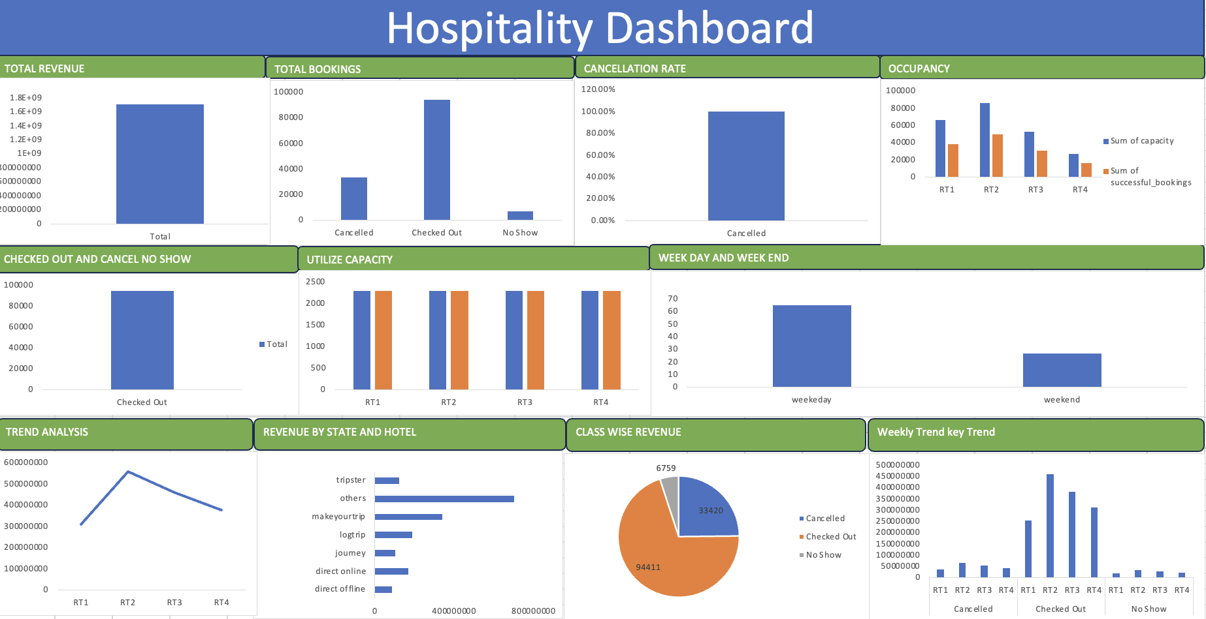
Dashboards

Slide 11
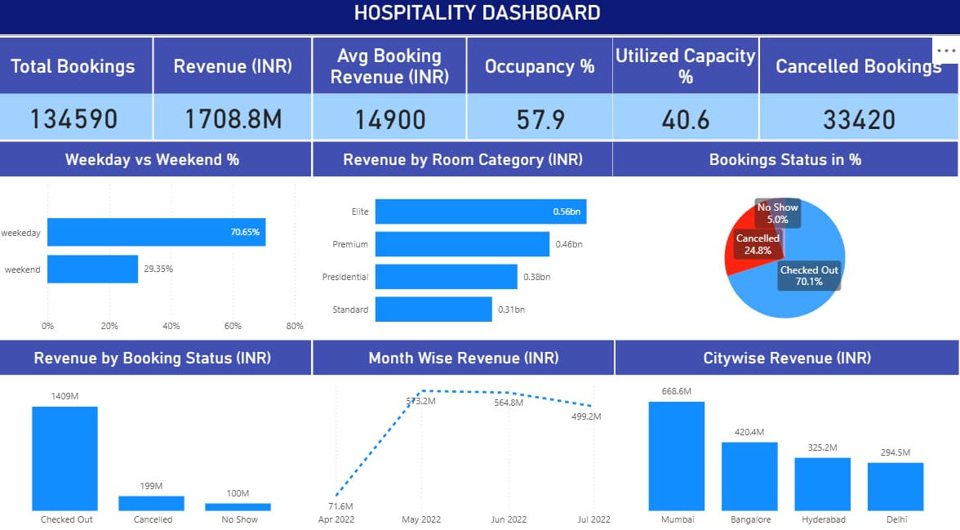
Dashboards

Slide 12
Project Conclusion
Revenue growth is mainly driven by luxury rooms and direct online bookings.
Cancellations and no-shows remain a major challenge, causing revenue leakage.
Occupancy is strong on weekends, while weekdays show underutilization.
Regional performance is uneven — a few states dominate, while others lag despite capacity.
Actionable insights from dashboards can guide pricing, marketing, and operational strategies.
Overall, hospitality analytics provides a data-driven approach to optimize revenue, enhance occupancy, and improve decision-making across hotels.

Slide 13

THANK YOU..

